Slide 1
ATI Regional Groups The New York Metro Model
Peggy Groce, Jonathan Rubell,
Louis Hoffman & Steve Gallo
August 11, 2012
Notes:
This template can be used as a starter file for presenting training materials in a group setting.
Sections
Right-click on a slide to add sections. Sections can help to organize your slides or facilitate collaboration between multiple authors.
Notes
Use the Notes section for delivery notes or to provide additional details for the audience. View these notes in Presentation View during your presentation.
Keep in mind the font size (important for accessibility, visibility, videotaping, and online production)
Coordinated colors
Pay particular attention to the graphs, charts, and text boxes.
Consider that attendees will print in black and white or grayscale. Run a test print to make sure your colors work when printed in pure black and white and grayscale.
Graphics, tables, and graphs
Keep it simple: If possible, use consistent, non-distracting styles and colors.
Label all graphs and tables.

Slide 2
Overview
Purpose
Outreach
Meeting Plans
Agenda

Slide 3
Purpose
Establishment of more regular contact
Increased possibilities of sharing and collaborating
Possible way to strengthen ATI
Promotion of travel training in the region

Slide 4
Outreach
Membership list in region
Initial contact
Interest determined
Agreement on meeting and location
Time available schedules

Slide 5
Meeting Preparation
Roles assumed
Contacts maintained
Meeting priorities
Agreement on date
Agenda drafts
Notification of meeting

Slide 6
Individual Preparation
Commitment
Participants
Travel
Host
Information for sharing

Slide 7
Regional Meeting
Agenda
Welcome and Introductions
Organizations’ Presentations – Matrix Development
Regional Travel Training Issues
Challenges
Establishing Goals
Summary

Slide 8
Matrices Used
Travel Instruction Services Offered Matrix
Individuals/Groups Served Matrix
Funding Matrix

Slide 9
Travel Instruction Services Offered Matrix
 |  | Services
Organization |  | Transit Orientation | Familiar-ization | One-to-One Short Term | One-to-One Compre-hensive | Mobility Management | Train-the-Trainer
AHRC
The Kennedy Center
NYC Board of Education
NJ TIP Inc.
Westchester County
YAI
Notes:
Travel instruction services offered by programs

Slide 10
Individuals/Groups Served Matrix
 |  | Customers
Organization |  | Students | Seniors | Persons with Disabilities | Professionals | Volunteers | Others
AHRC
The Kennedy Center
NYC Board of Education
NJ TIP Inc.
Westchester County
YAI

Slide 11
Funding Matrix
 |  | Funding
Organization |  | Transit Agency | School System | Voc Rehab | Foundations | New Freedom | Other
AHRC
The Kennedy Center
NYC Board of Education
NJ TIP Inc.
Westchester County
YAI

Slide 12
Challenges
Agreement that major challenges exist in clarifying differences between:
Travel training and mobility management
Travel training for individuals with disabilities and for senior citizens
Notes:
Mobility management was a challenge

Slide 13
Positive Outcomes of Meeting
Six organizations and 22 participants
Increased knowledge and understanding of the Region
Recognition of a doughnut hole in funding – “Voc rehab”
Vision of the tri-state transit system as a whole
Gaps and strengths in Region
Limitations and possibilities of organizations based on type, funding sources, and legal restrictions
Precedent in one area may setup success in another
Businesses, transit systems and others with Regional concerns meet to gain strength and influence … why not ATI members

Slide 14
Strengths of Regional Group
Divergent backgrounds
Different connections
Varied knowledge base
Common interest
The whole is greater
than the sum of its parts.

Slide 15
Idea Sharing
Sample Parking Lot
Come back at the end of session

Slide 16
Summary
Purpose
Outreach to regional members
Meeting location
Date and time
Agenda agreement

Slide 17
Follow Up
Minutes distributed
Completed matrices distributed
Continuing contact on issues/concerns

Slide 18
Future Sessions
Develop Presentations Together
Learn Together – Professional Development
Film Professional Development for website
Develop a Regional Timeline

Slide 19
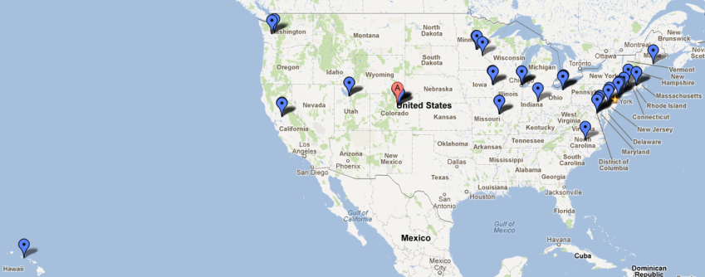
Map

Slide 20
Other options?
Phone Conferences
Webinars
Google Hangouts
Building an online network of resources
Notes:
Professional Development is another goal
Meeting and networking is a big part of this, get all of us to talk and get involved

Slide 21
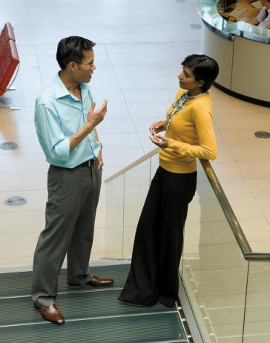
Who’s Who – Contact List
Lead | Contact information
Peggy Groce | mgroce@schools.nyc.gov
Louis Hoffman | lhoffman@njtip.org
Other | other@company.com
Other | other@company.com
Notes:
Keep it brief. Make your text as brief as possible to maintain a larger font size.

Slide 22
Questions?

